Slide 1

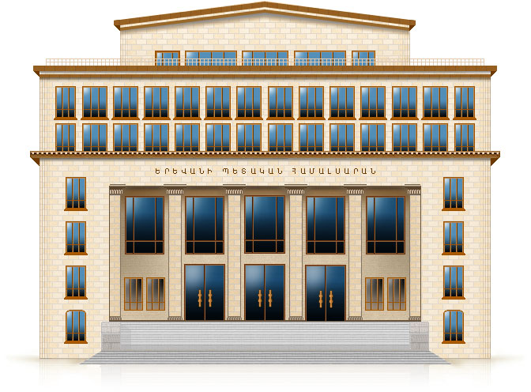

Quantum Effects From Boundaries in de Sitter and anti-de Sitter spaces
Aram Saharian
Department of Physics,
Yerevan State University, Armenia
_________________________________________
The Modern Physics of Compact Stars and Relativistic Gravity,
18 September – 21 September, 2013, Yerevan, Armenia

Slide 2
Content
Motivation
Quantum vacuum and the Casimir effect
Quantum effects in de Sitter spacetime
Quantum effects in anti-de Sitter spacetime
Applications to Randall-Sundrum-type braneworlds
Conclusions

Slide 3
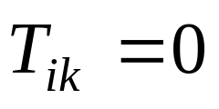
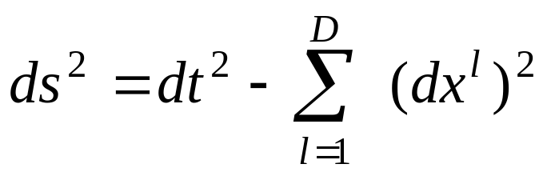
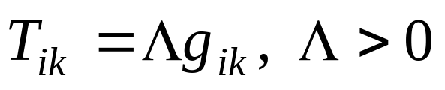
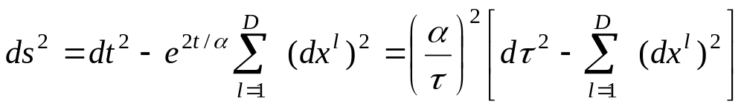
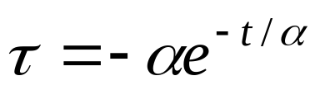
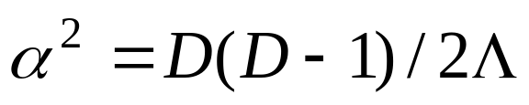
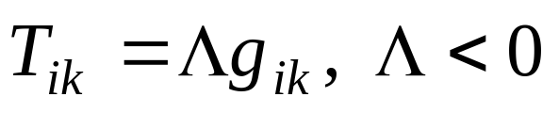
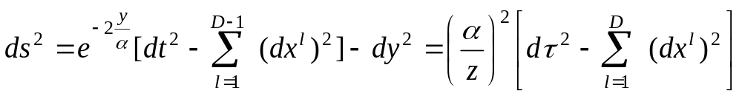
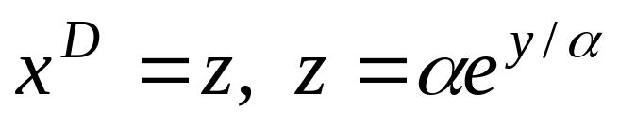
Maximally symmetric solutions of Einstein equations
Minkowski spacetime:
Cosmological constant
De Sitter (dS) spacetime:
Conformal time
Anti-de Sitter (AdS) spacetime:

Slide 4
Quantum fields in curved spacetime
Quantum fields are mainly considered in Minkowski spacetime
From late 60s Quantum Field Theory in curved spacetime
Gravity is treated as a classical field
Background Fields: Cosmological models, Schwarzshild spacetime, …
dS and AdS spacetimes have attracted special attention

Slide 5
Why de Sitter space-time?
De Sitter (dS) space-time is the maximally symmetric solution of the Einstein equations with the positive cosmological constant
Due to the high symmetry numerous physical problems are exactly solvable on dS background and a
Better understanding of physical effects in this bulk could serve as a handle to deal with more complicated geometries
In most inflationary models an approximately dS spacetime is employed to solve a number of problems in standard cosmology
At the present epoch the Universe is accelerating and can be well approximated by a world with a positive cosmological constant

Slide 6
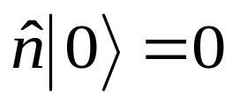
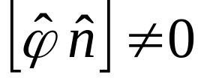
Quantum vacuum
Among the most important consequences of quantum field theory is the prediction of non-trivial properties of the vacuum
Vacuum is a state of quantum field with zero number of quanta
Field and particle number operators do not commute
In the vacuum state the field fluctuates:
Particle number operator
Field operator
Vacuum or zero-point fluctuations of a quantum field

Slide 7
Quantum vacuum in external fields
Properties of the vacuum are manifested in its response to external influences (vacuum polarization in external fields, particle creation from the vacuum)
Among the most important topics is the investigation of the structure of quantum vacuum in external gravitational fields
Applications: Physics of the Early Universe, Black Holes, Large Scale Structure of the Universe, CMB Temperature Anisotropies

Slide 8



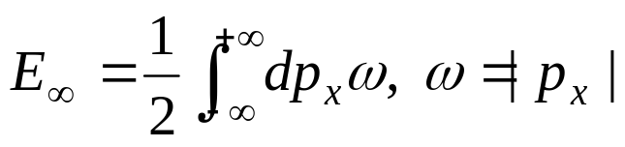


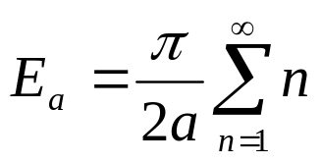
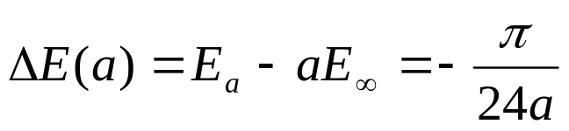
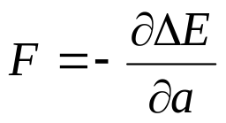
Casimir effect
Boundaries can serve as a simple model of external fields
The presence of boundaries modifies the spectrum of vacuum fluctuations The vacuum energy is changed Forces arise acting on boundaries
Casimir effect
Example: 2D massless scalar field with Dirichlet BC:
Boundaries are absent
Momentum
Vacuum energy
Boundaries are present
Wave number
Vacuum energy
Change in the vacuum energy:
Vacuum force:

Slide 9


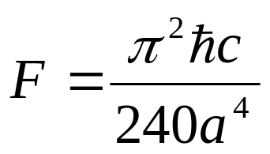
Ideal metal parallel plates
Two conducting neutral parallel plates in the vacuum attract by the force per unit surface (Casimir,1948)
Conducting plates

Slide 10
Casimir effect on curved backgrounds
An interesting topic in the investigations of the Casimir effect is its dependence on the geometry of the background spacetime
Relevant information is encoded in the vacuum fluctuations spectrum and analytic solutions can be found for highly symmetric geometries only
Maximally symmetric curved backgrounds: dS and AdS spacetimes

Slide 11

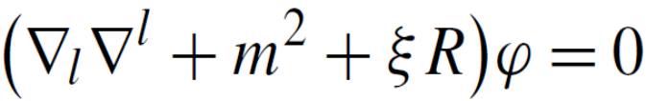
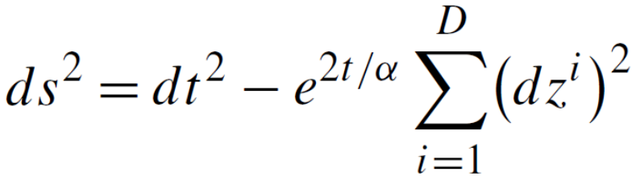
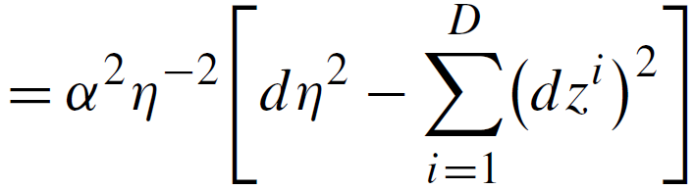
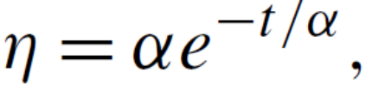


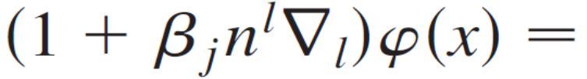

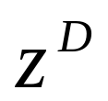
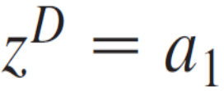
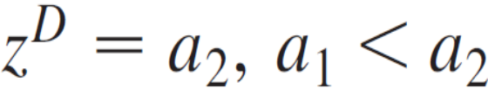
dS Space: Field and Boundary Geometry
Field: Scalar field with curvature coupling parameter
Bulk geometry: (D+1)-dimensional dS space-time
Cosmological constant
Boundary geometry: Two infinite parallel plates with Robin BC

Slide 12
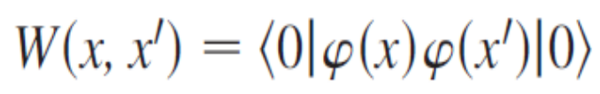
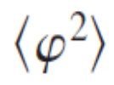





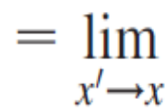
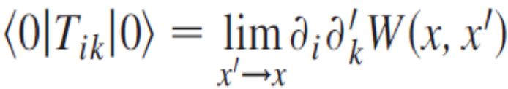
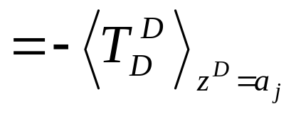
Characteristics of the vacuum state
Wightman function
Vacuum expectation value (VEV) of the field squared
VEV of the energy-momentum tensor
Vacuum forces acting on the boundaries
Evaluation scheme
Complete set of solutions to the classical field equation
Vacuum force per unit surface of the plate

Slide 13

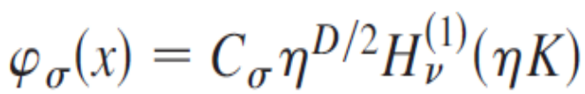

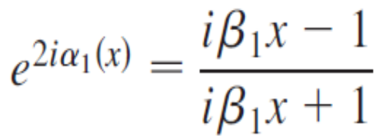
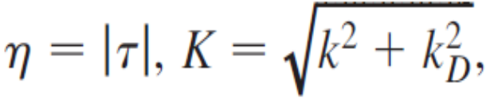





Eigenfunctions
We assume that the field is prepared in the Bunch-Davies vacuum state
Eigenfunctions in the region between the plates,
From the BC on the second plate ( )
Eigenvalues:

Slide 14



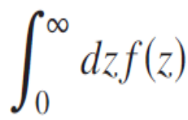


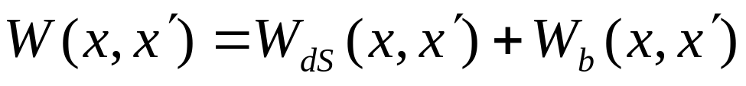
Wightman function
Mode sum:
Contains summation over
Summation formula
Wightman function is decomposed as
WF for boundary-free dS spacetime
Boundary-induced part

Slide 15

Renormalization
For points away from the boundaries the divergences are the same as for the dS spacetime without boundaries
We have explicitly extracted the part
The renormalization of the VEVs is reduced to the renormalization of the part corresponding to the geometry without boundaries

Slide 16
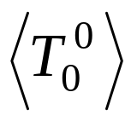
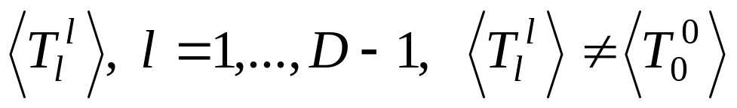
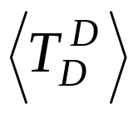
VEV of the energy-momentum tensor: Diagonal components
Vacuum energy density:
Parallel stresses = - vacuum effective pressures parallel to the boundaries:
In Minkowski spacetime Parallel stresses = Energy density
Normal stress = - vacuum effective pressure normal to the boundaries:
Determines the vacuum force acting on the boundaries

Slide 17
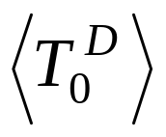
Off-diagonal component
VEV of the energy-momentum tensor
Nonzero off-diagonal component :
Corresponds to energy flux along the direction perpendicular to the plates
Depending on the values of the coefficients in the boundary conditions and of the field mass, this flux can be positive or negative
Geometry of a single boundary
Plate
Plate
Energy flux
Energy flux

Slide 18
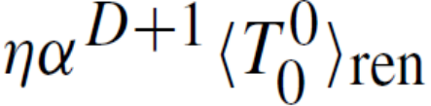
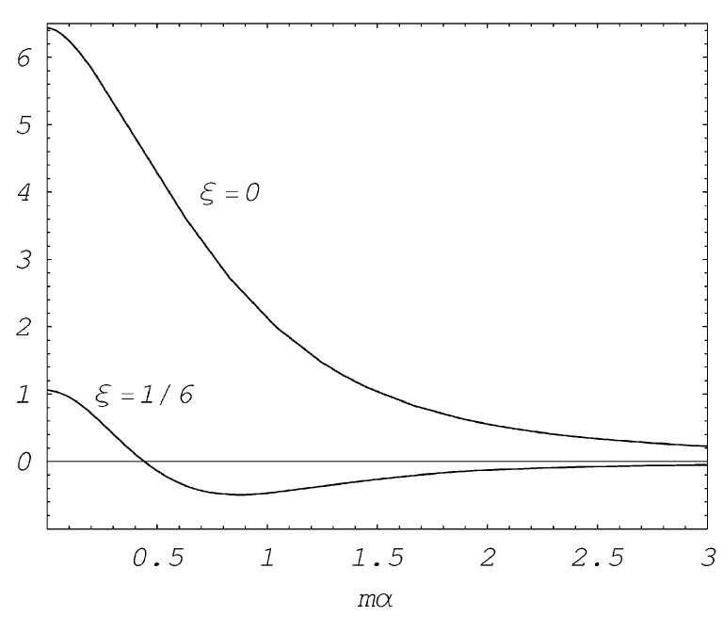



Boundary-free energy density
Renormalized vacuum energy density in D=3 dS space-time
dS
minimally coupled field
conformally coupled field

Slide 19
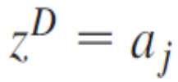

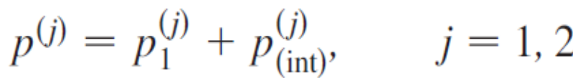




Casimir forces
The vacuum force acting per unit surface of the plate at is determined by the component of the vacuum energy-momentum tensor evaluated at this point
For the region between the plates, the corresponding effective
pressures can be written as
Pressure for a single plate
Pressure induced by the the second plate

Slide 20


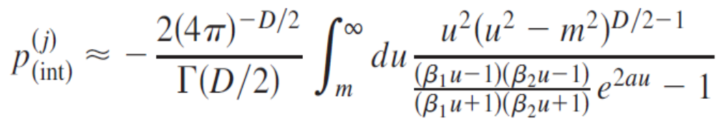
Casimir forces: Properties
Depending on the values of the coefficients in the boundary conditions, the effective pressures can be either positive or negative, leading to repulsive or to attractive forces
For the Casimir forces acting on the left and on the right plates are different
In the limit the corresponding result for the geometry of two parallel plates in Minkowski spacetime is obtained

Slide 21

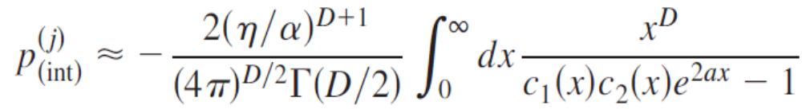



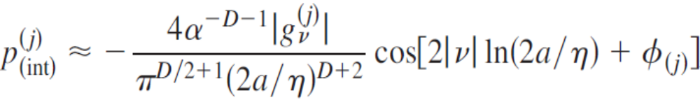


Casimir forces: Asymptotics
Proper distance between the plates is smaller than the curvature radius of the background spacetime:
In the case of Dirichlet BC on one plate and non-Dirichlet one on the other the vacuum force at small distance is repulsive
In all other cases the forces are attractive
At large distances, , and for positive values of
At large distances and for imaginary values of

Slide 22

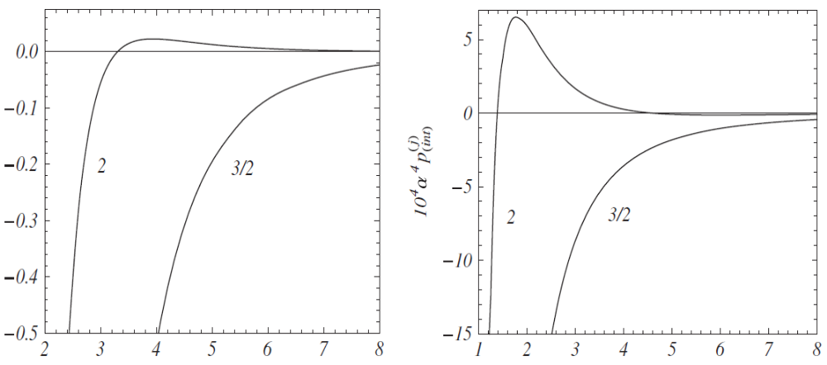


Casimir forces between the plates for a D = 3 minimally coupled scalar field
Dirichlet BC
Neumann BC

Slide 23

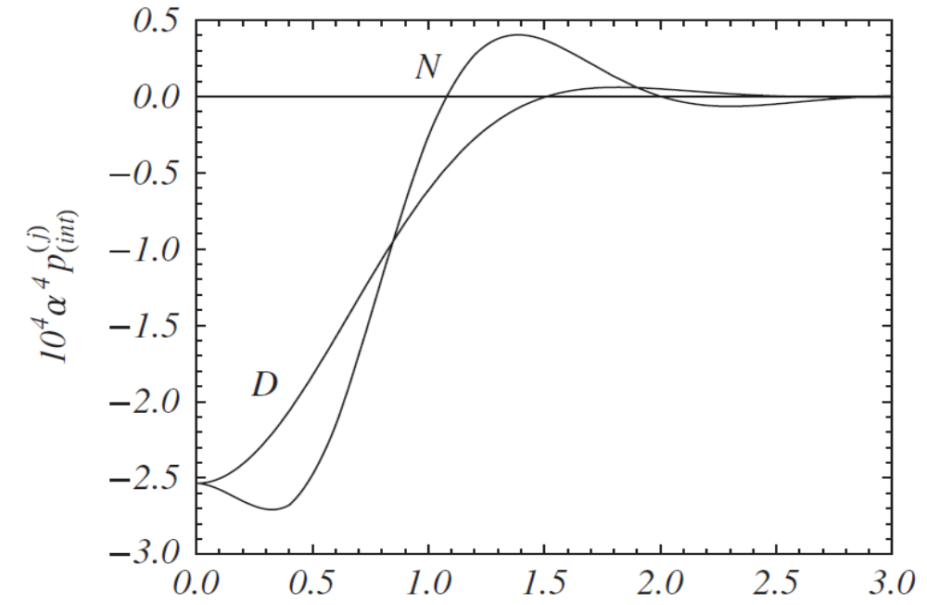

Casimir forces between the plates for a D = 3 conformally coupled scalar field

Slide 24


Conclusions
For the proper distances between the plates larger than the curvature radius of the dS spacetime, , the gravitational field essentially changes the behavior of the Casimir forces compared with the case of the plates in Minkowski spacetime
In particular, the forces may become repulsive at large separations between the plates
A remarkable feature of the influence of the gravitational field is the oscillatory behavior of the Casimir forces at large distances, which appears in the case of imaginary
In this case, the values of the plate distance yielding zero Casimir force correspond to equilibrium positions. Among them, the positions with negative derivative of the force with respect to the distance are locally stable

Slide 25


Conclusions
In dS spacetime, the decay of the VEVs at large separations between the plates is power law (monotonical or oscillating), independently of the field mass
This is quite remarkable and clearly in contrast with the corresponding features of the same problem in a Minkowski bulk. The interaction forces between two parallel plates in Minkowski spacetime at large distances decay as for massless fields, and these forces are exponentially suppressed for massive fields by a factor of

Slide 26
Why anti-de Sitter?
Questions of principal nature related to the quantization of fields propagating on curved backgrounds
AdS spacetime generically arises as a ground state in extended supergravity and in string theories
AdS/Conformal Field Theory correspondence: Relates string theories or supergravity in the bulk of AdS with a conformal field theory living on its boundary
Braneworld models: Provide a solution to the hierarchy problem between the gravitational and electroweak scales. Naturally appear in string/M-theory context and provide a novel setting for discussing phenomenological and cosmological issues related to extra dimensions

Slide 27
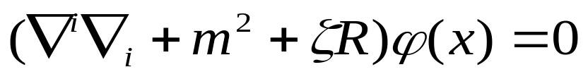
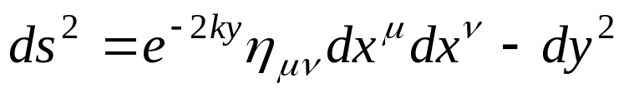

Quantum effects in AdS bulk
Field: Scalar field with an arbitrary curvature coupling parameter
Bulk geometry: (D+1)-dimensional spacetime with the line element
1/k AdS curvature radius
Boundaries (Branes): Located at y=a and y=b
Boundary conditions:

Slide 28




Randall-Sundrum braneworld models
Bulk geometry: 5-dimensional AdS spacetime
RS two-brane model
Warp factor,
Orbifolded y-direction: S¹/Z₂
Orbifold fixed points (locations of the branes)
y=0 y=L
RS single brane model
brane
Warp factor
Z₂ identification
y=0 y

Slide 29



Energy-momentum tensor
Decomposition of the EMT
Vacuum EMT is diagonal
+
Part induced by a single brane at y=a
+
Part induced by a single brane at y=b
+
Interference part
Vacuum energy density
Vacuum pressures in directions parallel to the branes
Vacuum pressure perpendicular to the branes

Slide 30
Vacuum forces
At separations between the branes larger than the AdS
curvature radius the vacuum forces are exponentially suppressed
In dependence of the coefficients in the boundary conditions
the vacuum interaction forces between the branes can be either
attractive or repulsive
Vacuum pressure on the brane
Interbrane distance
Vacuum forces are repulsive for small distances and are attractive for large distances
Stabilization of the interbrane distance (radion field) by vacuum forces

Slide 31





Surface energy-momentum tensor
Total vacuum energy per unit coordinate surface on the brane
Volume energy in the bulk
In general
Difference is due to the presence of the surface energy located on the boundary (A.Romeo, A.A.Saharian, J.Phys.A,2002)
For a scalar field on manifolds with boundaries the energy-momentum tensor in addition to the bulk part contains a contribution located on the boundary (A.A.Saharian, Phys.Rev.D,2003)
Extrinsic curvature tensor
Induced metric
Unit normal

Slide 32
Surface EMT and induced cosmological constant
Vacuum expectation value of the surface EMT on the brane at y=j
This corresponds to the generation of the cosmological constant on the branes by quantum effects
Induced cosmological constant is a function on the interbrane distance, AdS curvature radius, and on the coefficients in the boundary conditions
In dependence of these parameters the induced cosmological constant can be either positive or negative

Slide 33





Physics for an observer on the brane
D-dimensional Newton’s constant measured by an observer on the brane at y=j is related to the fundamental (D+1)-dimensional Newton’s constant by the formula
For large interbrane distances the gravitational interactions on the brane y=b are exponentially suppressed. This feature is used in the Randall-Sundrum model to address the hierarchy problem
Same mechanism also allows to obtain a naturally small cosmological constant on the brane generated by vacuum fluctuations
Cosmological constant on the brane y=j
Effective Planck mass on the brane y=j

Slide 34


Induced cosmological constant in the Randall-Sundrum brane model
For the Randall-Sundrum brane model D=4, the brane at y=a corresponds to the hidden brane and the brane at y=b corresponds to the visible brane
Observed hierarchy between the gravitational and electrowek scales is obtained for
For this value of the interbrane distance the cosmological constant induced on the visible brane is of the right order of magnitude with the value implied by the cosmological observations
AdS bulk
Hidden brane
Visible brane
Location of Standard Model fields

Slide 35
Conclusions
For mixed boundary conditions the vacuum forces between the branes in AdS bulk can be either repulsive or attractive
There is a region in the space of Robin parameters in which
the forces are repulsive for small distances and
are attractive for large distances, providing a possibility to
stabilize interbrane distance by using vacuum forces
Quantum fluctuations of a bulk scalar field induce surface
densities of the cosmological constant type localized on the branes
In the original Randall-Sundrum model for interbrane distances
solving the hierarchy problem, the value of the cosmological
constant on the visible brane by order of magnitude is in agreement with the value suggested by current cosmological
observations without an additional fine tuning of the parameters

Slide 36
Thank You!

